Slide 1

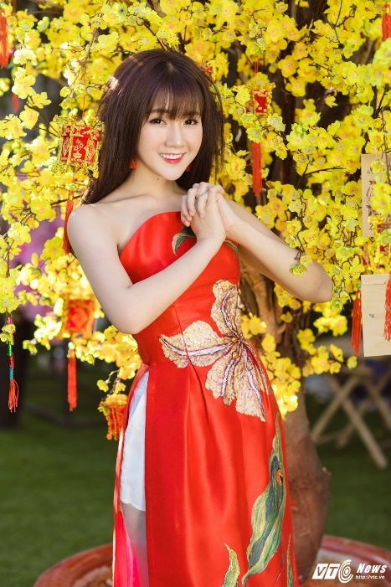
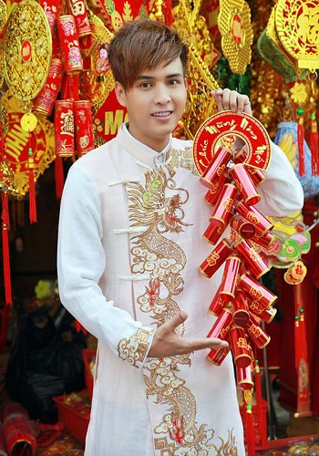
FASHION
TRADITIONAL
ONLINE
Relevant Data
*
*
*
*
*
*
For woman
For male

